Slide 1
Rocket Motors

Slide 2
Rocket Propulsion
Solid Fueled Rockets
Liquid Fueled Rockets
Hybrid Rockets

Slide 3
How Engines Work
In order for something to burn, you need a fuel + oxidizer
Fuel – the chemical that burns
Oxidizer – the thing that causes the burning
Compare this to airplanes
Where is their oxidizer?
Motor vs engine
Notes:
Motor is simple device that stores propellant, engine is more complicated with moving parts to convert stored propellant into thrust

Slide 4
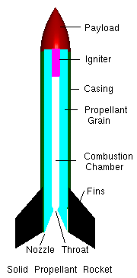
Solid Propulsion

Slide 5
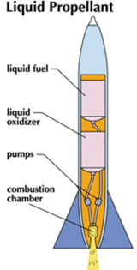
Liquid Propulsion

Slide 6
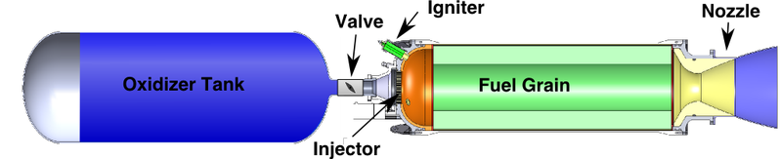
Hybrid Propulsion

Slide 7
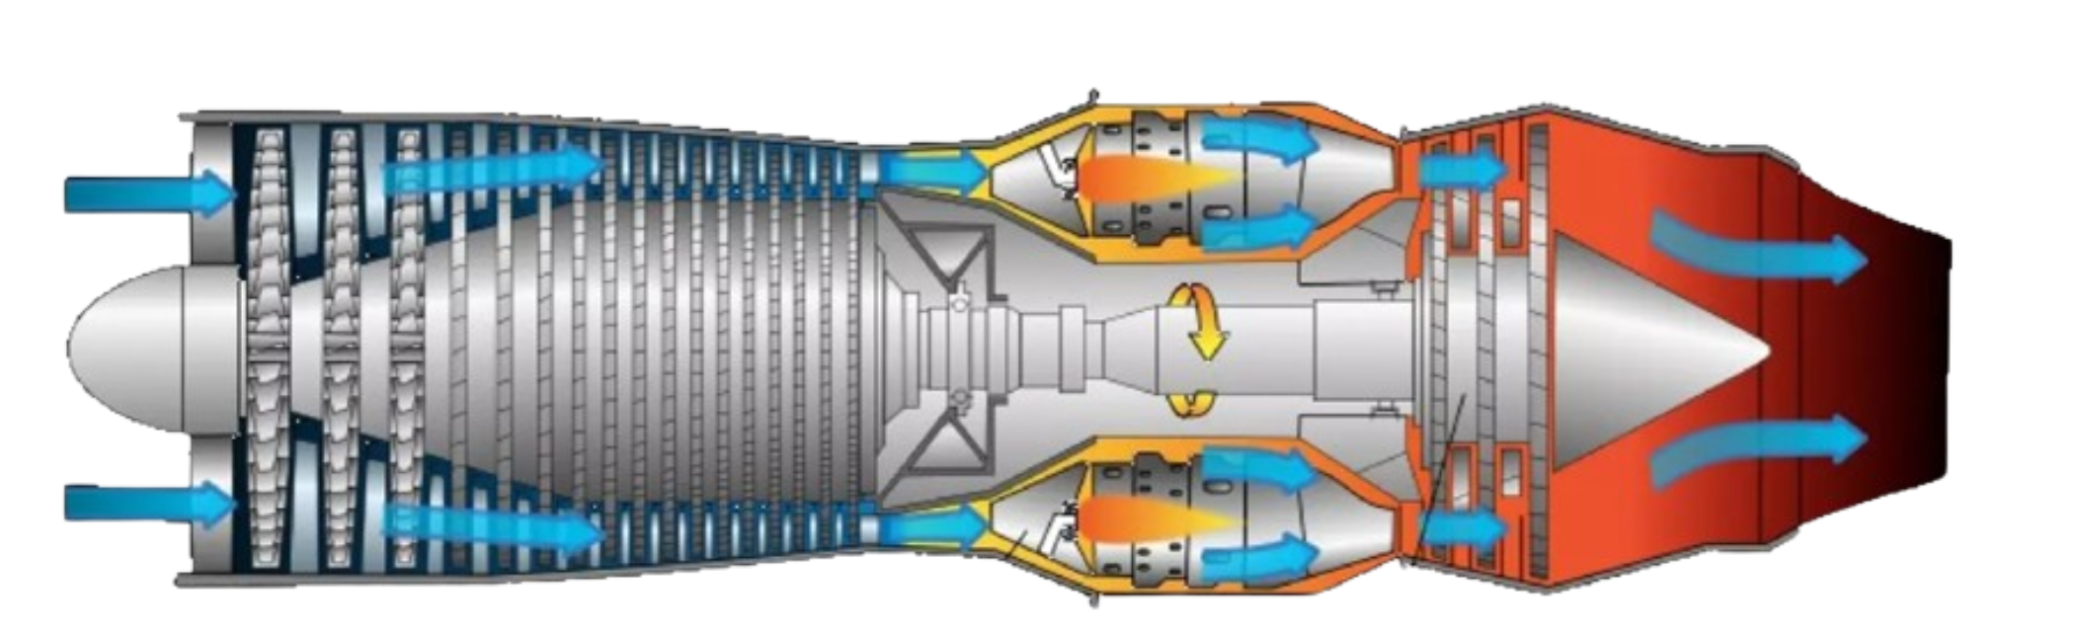
Airplane Motors

